Slide 1

STUDENT PROECT SHOW CASE
PRESENTED BY:
MUPPIDI RANJITH KUMAR : 25MVCSMR422
MUDUNURI SUSHANTH : 25MVCSMR421
BOROOJU RAMCHETHAN : 25MVCSMR379
YANAMONI ABHIRAM : 25MVCSMR450

Slide 2
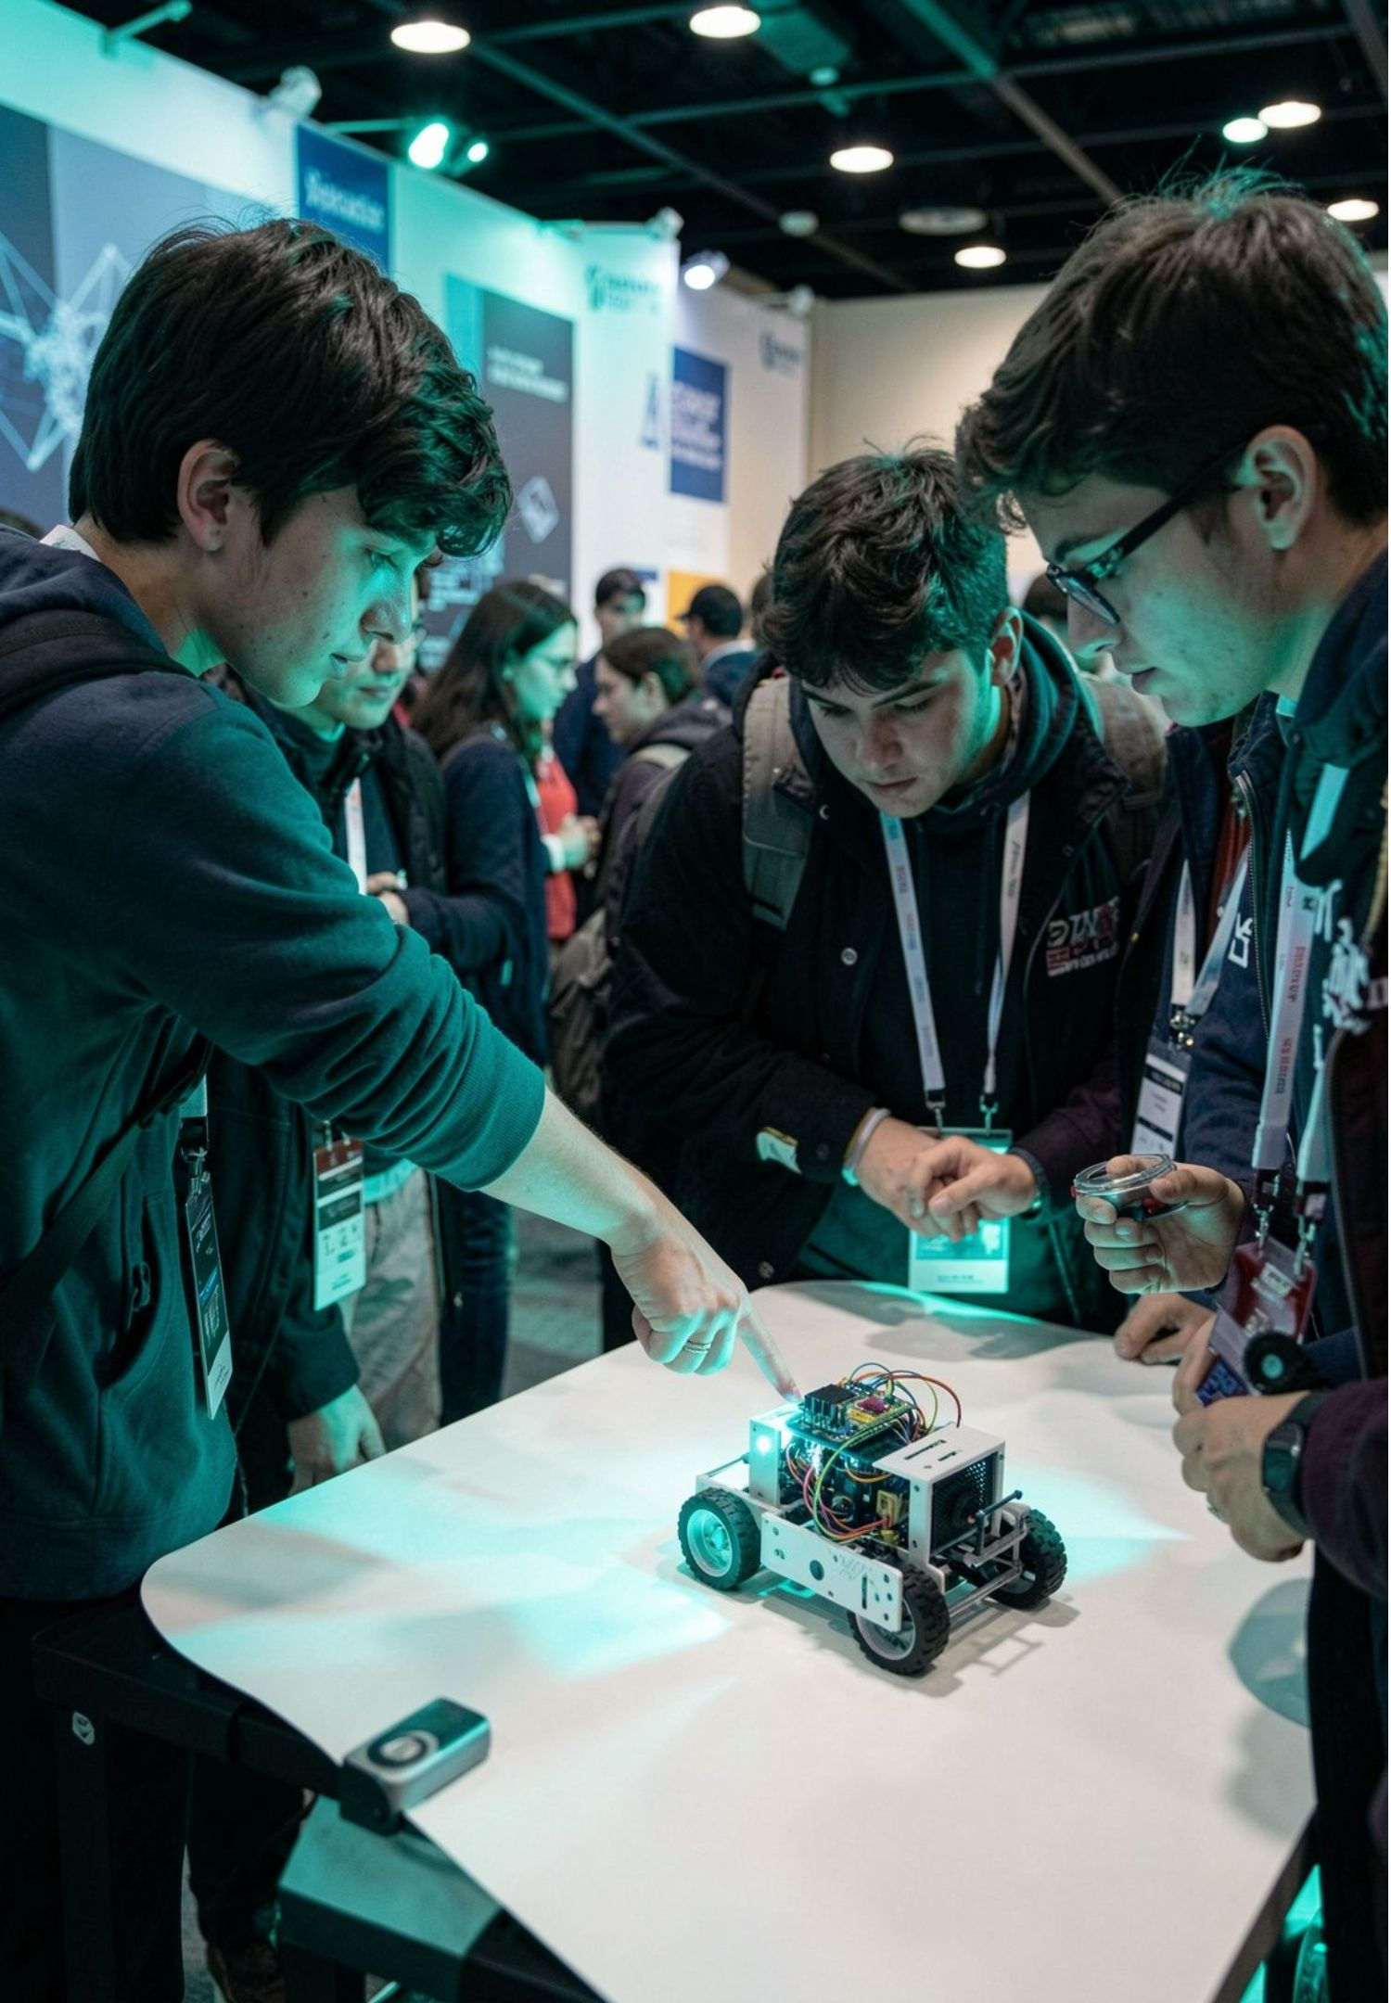
What is a student project showcase?
A platform where students present projects, prototypes, research, and technical ideas.
It demonstrates knowledge, creativity, and practical engineering skills.
Projects can be software, hardware, research, or community problem-solving.
Students communicate through demonstrations, posters, presentations, and working models.

Slide 3
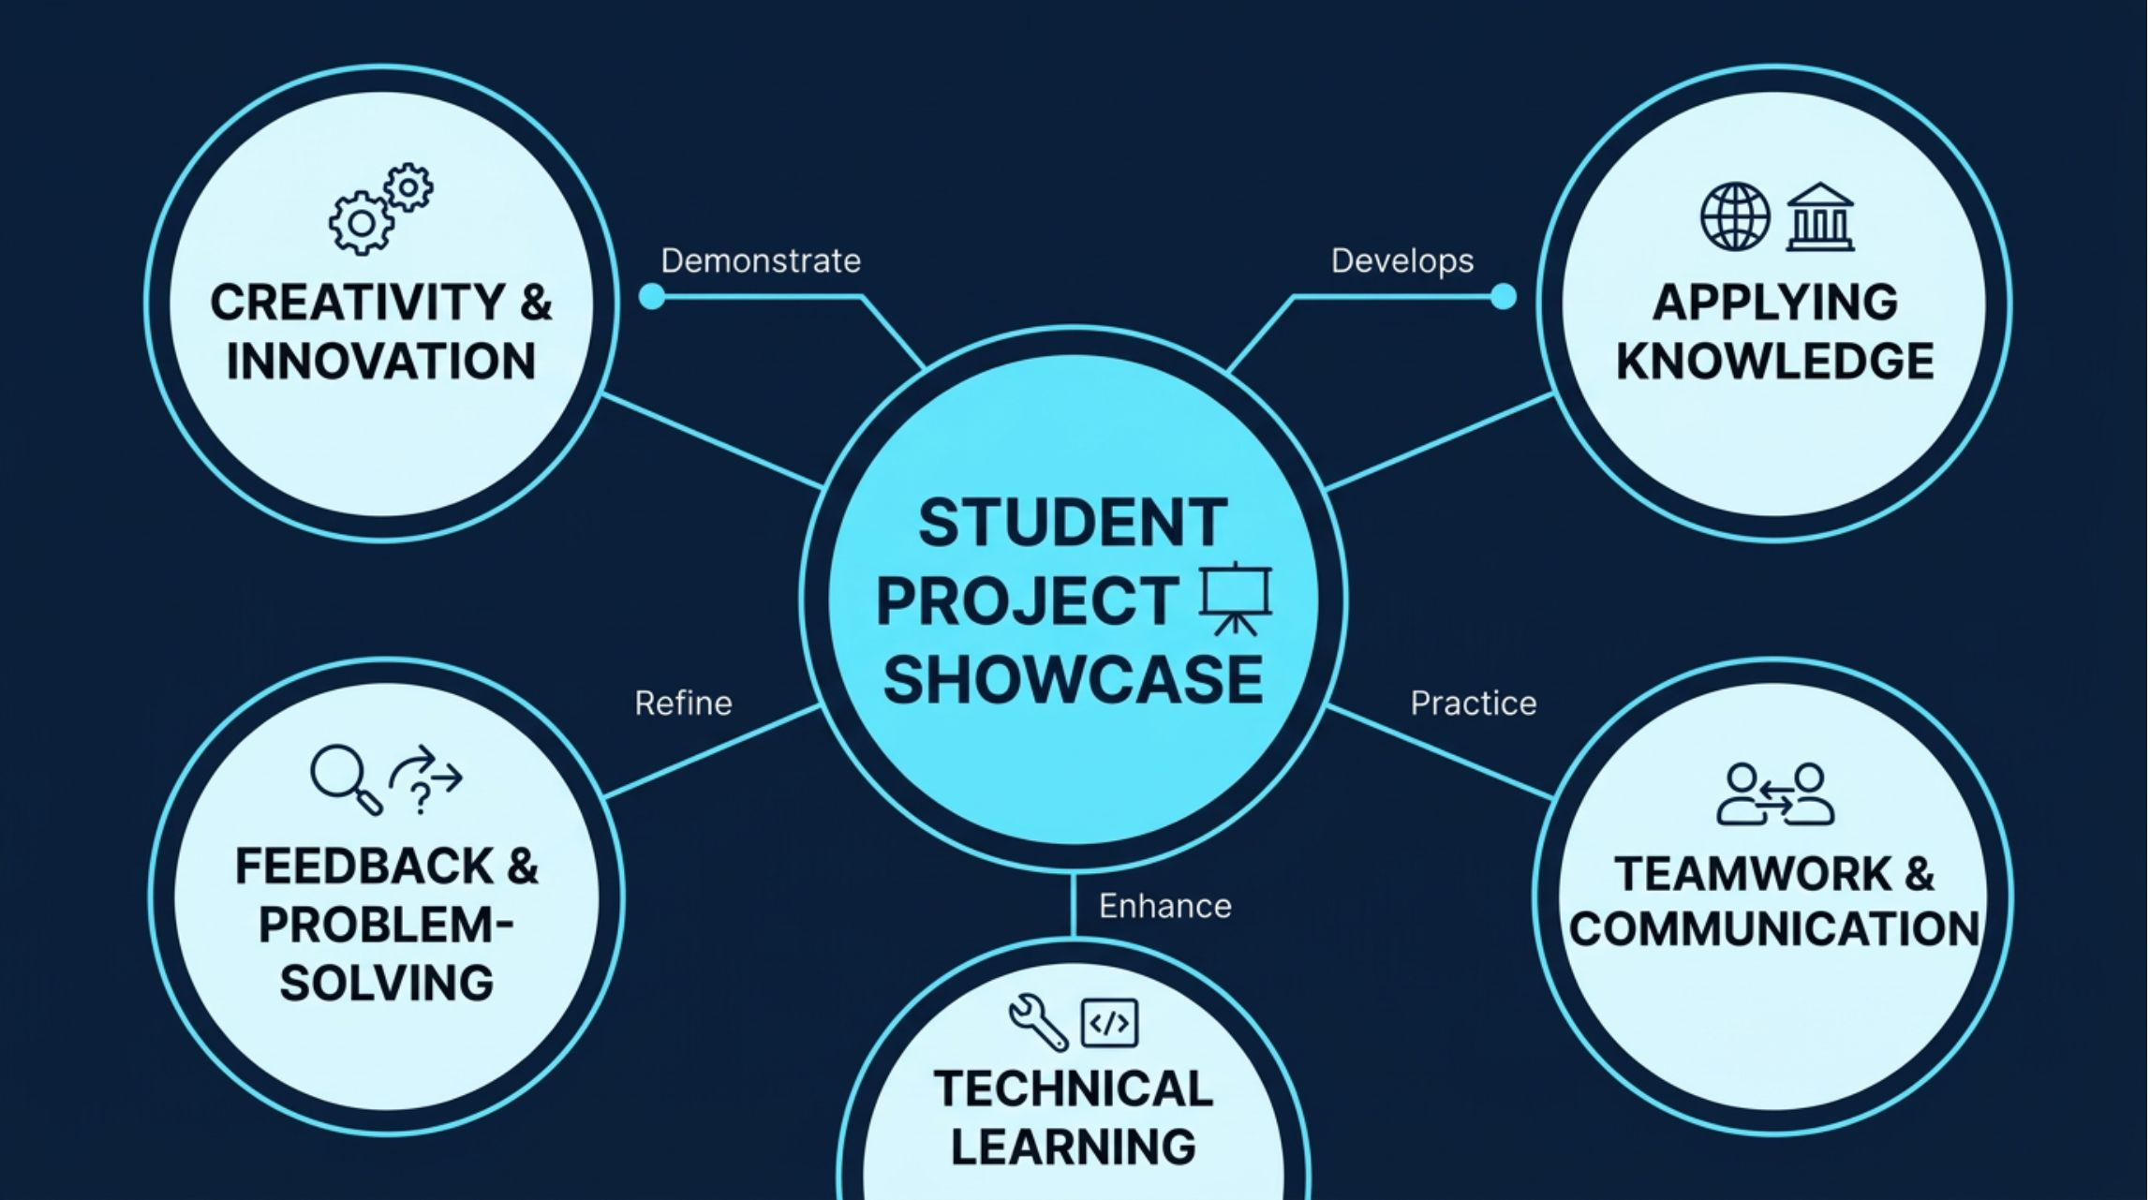
THE VALUE OF SHOWING THE WORK
Why it matters
A showcase connects classroom knowledge with the habits engineers need in practice.

Slide 4




FOUR BUILDING MODES
Four ways students build
Different tools, same goal: make an idea useful in the real world.
Software
Hardware
Research
Social innovation
Websites, mobile apps, AI tools, and student management systems.
Robotics, Internet of Things (IoT) devices, sensors, and smart automation.
Experiments, data analysis, simulations, and technical investigations.
Solutions for waste management, water conservation, and energy saving.
Example: campus timetable app
Example: automatic plant-watering system
Example: comparing sensor readings
Example: bin-level alert system

Slide 5
THE BUILD LOOP
From problem to prototype
Good projects move from a real need to a tested solution, then improve through feedback.
01
02
03
04
05
06
Identify
Research
Select
Build
Present
Improve
Find a real-world problem.
Plan a practical solution.
Choose tools and technologies.
Design, develop, and test.
Prepare the demonstration.
Collect feedback and refine.
Teamwork
Testing
Time management
Clear documentation

Slide 6
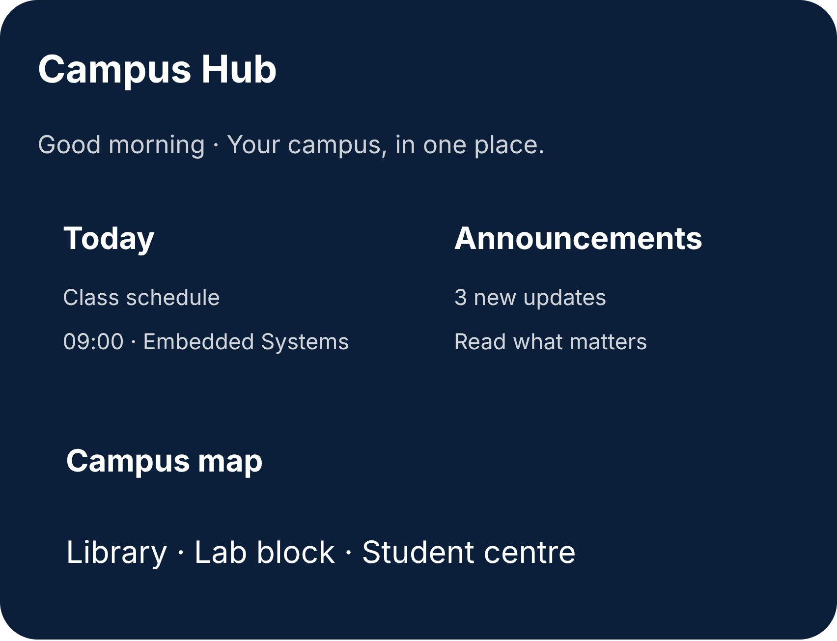
Smart Campus
Assistant
HYPOTHETICAL STUDENT PROJECT — NOT VERIFIED OR COMPLETED
Problem: Students may find it difficult to access campus information from different sources.
Solution: A mobile or web app that organizes class schedules, announcements, campus maps, and event information.
Technologies: HTML, CSS, JavaScript, and a suitable database, depending on implementation.
Future improvements: AI-powered assistance, personalized notifications, and integration with college systems.
Expected benefits: easier access to information, improved organization, and convenient campus navigation.

Slide 7
THANK YOU!
A Student Project Showcase transforms ideas into practical learning experiences.
Learn. Build. Innovate. Inspire.
Questions & Answers

